Slide 1
Admob Splash Ads
Kris

Slide 2
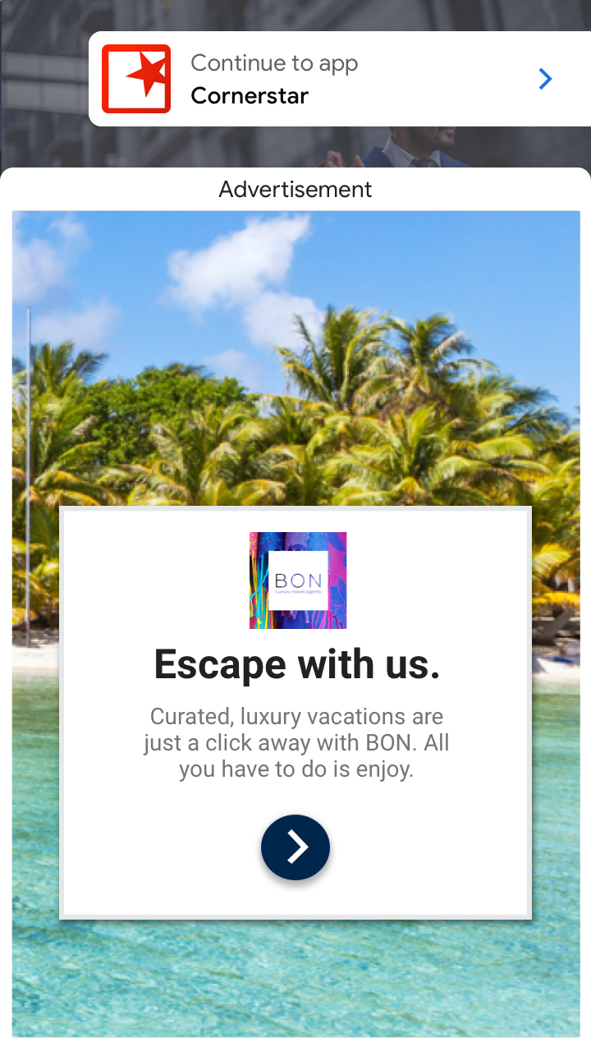
Admob App Open Ads Beta
Return to app
https://developers.google.com/admob/android/early-access/app-open-ads-beta
Start the app
or bring it to the foreground

Slide 3
Admob App Open Ads Beta
App open ads automatically show a small branding area so users know they're in your app.
That is, you can let your app be seen in the background.
You have to press the button to close the splash ad.

Slide 4
Development Guide
https://developers.google.com/admob/android/early-access/app-open-ads-beta
Suggestion
To show ad as quickly as possible, it's best to load your ad before you need to display it.
That way, you'll have an ad ready to go as soon as your user enters into your app.
Implementation
LifecycleObserver
Implement the LifecycleObserver interface to be notified when your app comes into the foreground.
AppPrefetcher Implement the AppPrefetcher class to make a ad request.
AdPresentationActivity Implement the AdPresentationActivity to display the ad when your app is opened.

Slide 5
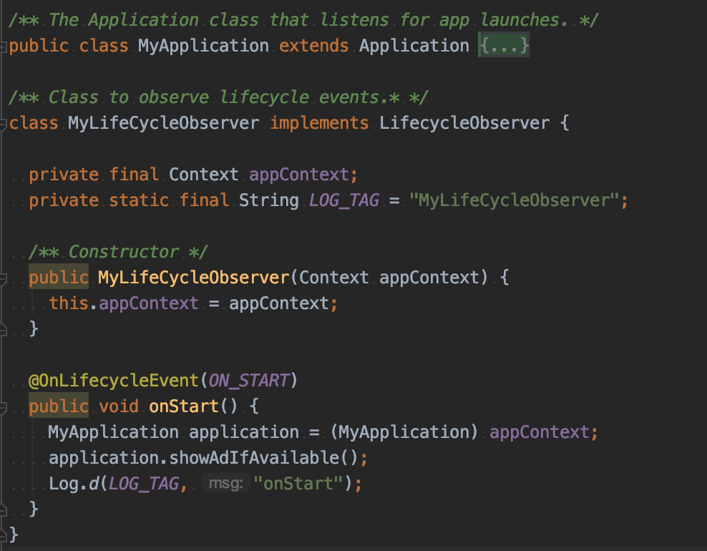
LifecycleObserver
Listen to the application ON_START event.

Slide 6
Suggested Implementation
LifecycleObserver
Listen to ON_START event
Is Available Ad?
NO
AppPrefetcher
Fetch a new ad
Go to MainActivity
YES
*For the next open
AdPresentationActivity
Show SplashAd
*Splash Ad shows only if there is an available ad.
*Do NOT wait for a new ad being loaded

Slide 7
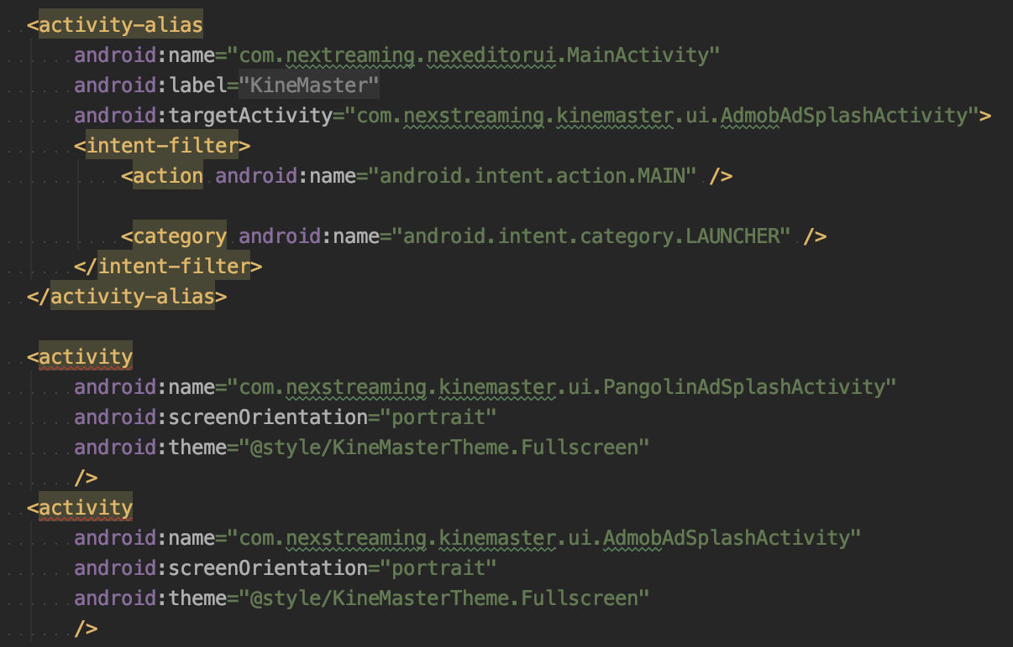
Implementation
//branch: feature/admob_splash_ad
Refers to China ver.
Add AdmobAdSplashActivity to request splash ad and show.

Slide 8

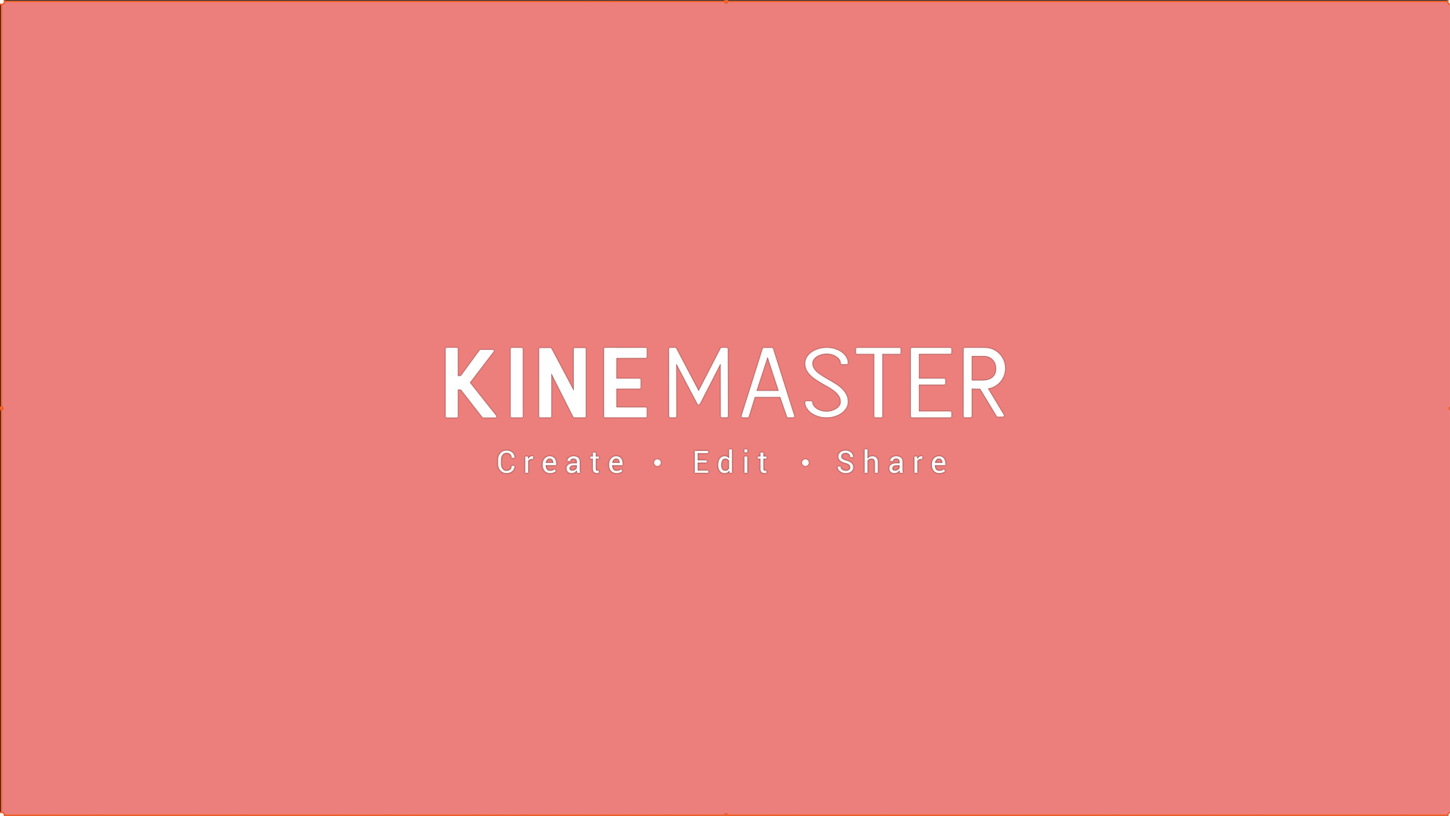
China ver.
Start PangolinAdSplashActivity
isLoadedSuccess?
Request Ad
Splash AD
YES
Wait 5 sec
Show Splash Ad
Go to SplashActivity
Check permissions

Slide 9
Show Ad
Start app / Bring app to the foreground
isSubscription or isFirstLaunch?
YES
*Ask the design team for a new screen to be shown while the splash ad is loading.
NO
isShowingAd?
YES
Fetch a new ad
Go to MainActivity
NO
isLoadedSuccess?
isAd Available?
NO
NO
YES
YES
Show SplashAd

Slide 10
Close Ad
SplashAd is showing
Click the Back key
Click “Continue to app”
Close Ad
Go to MainActivity

Slide 11
Differences with China ver.
A new logo screen for GP ver..
//wait for the design team support (DESU-262)
Splash ad will NOT close automatically.
You have to press the “Continue to app” / “Back” button to close the splash ad.
In China ver., the splash ad will be closed after 5 sec.
The ad will be closed if the “Back” button on the action bar is pressed.
In China ver., the app will be brought to the background.

Slide 12
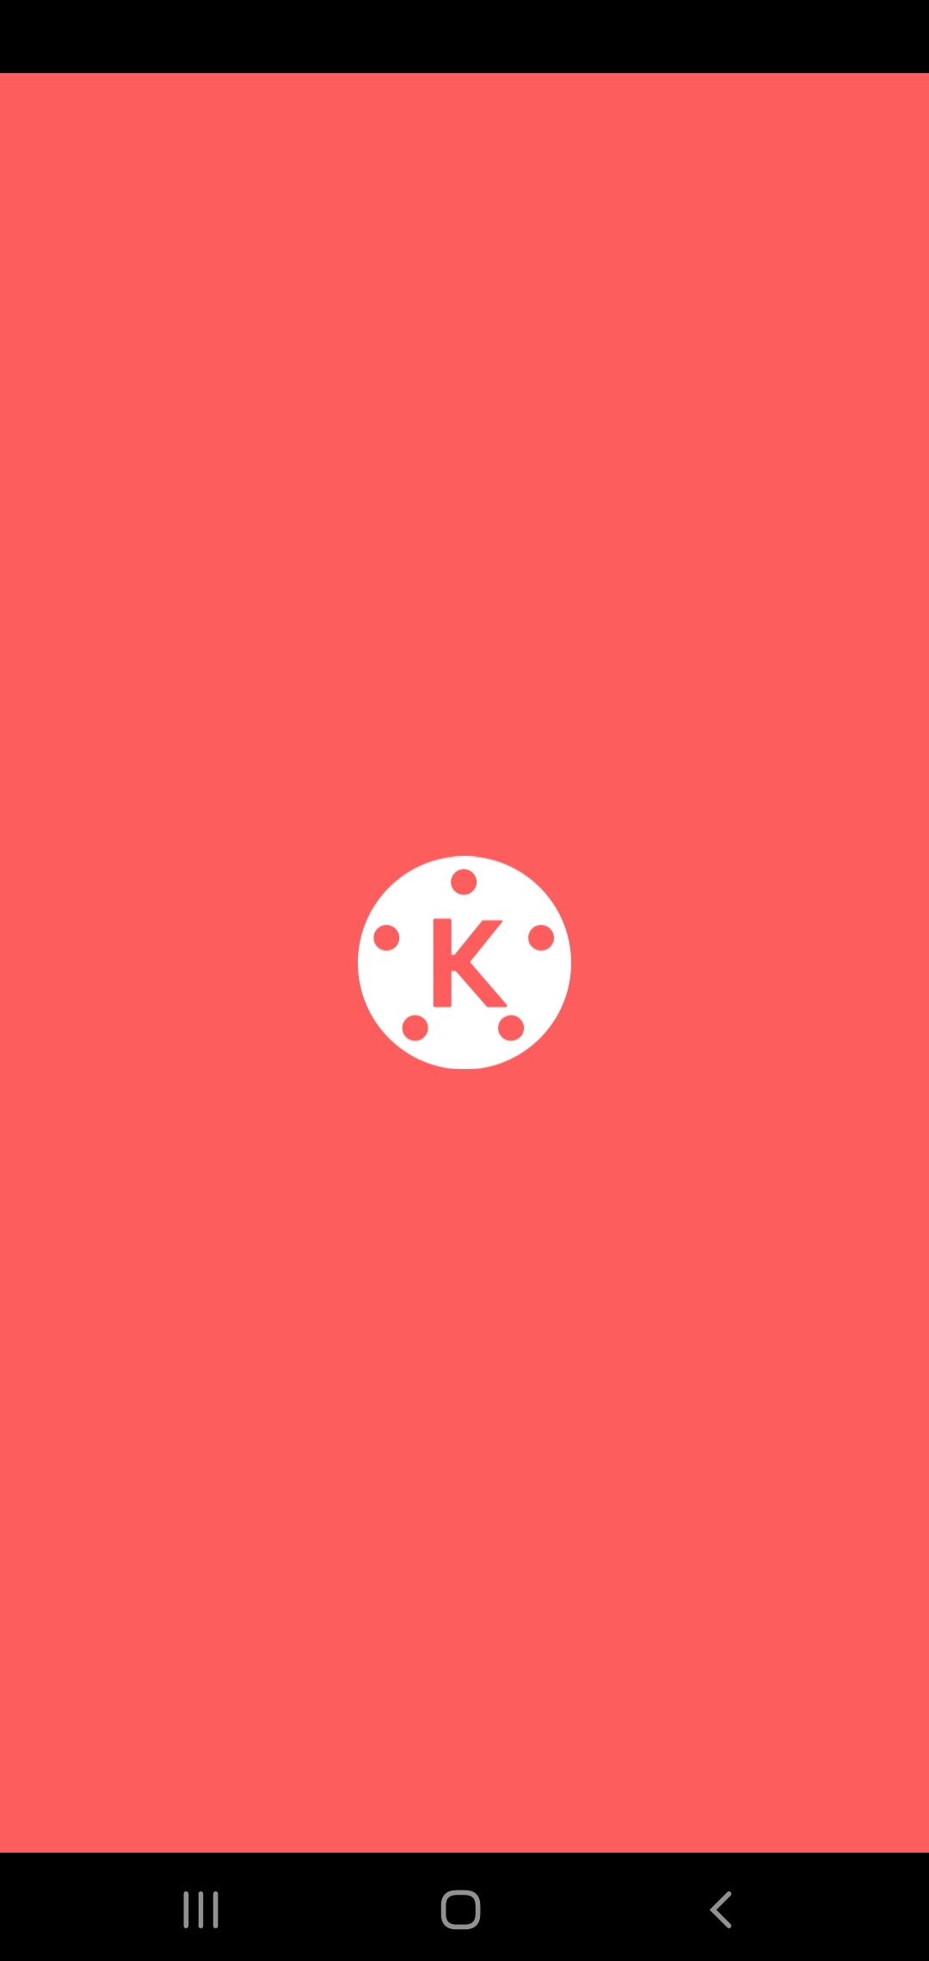
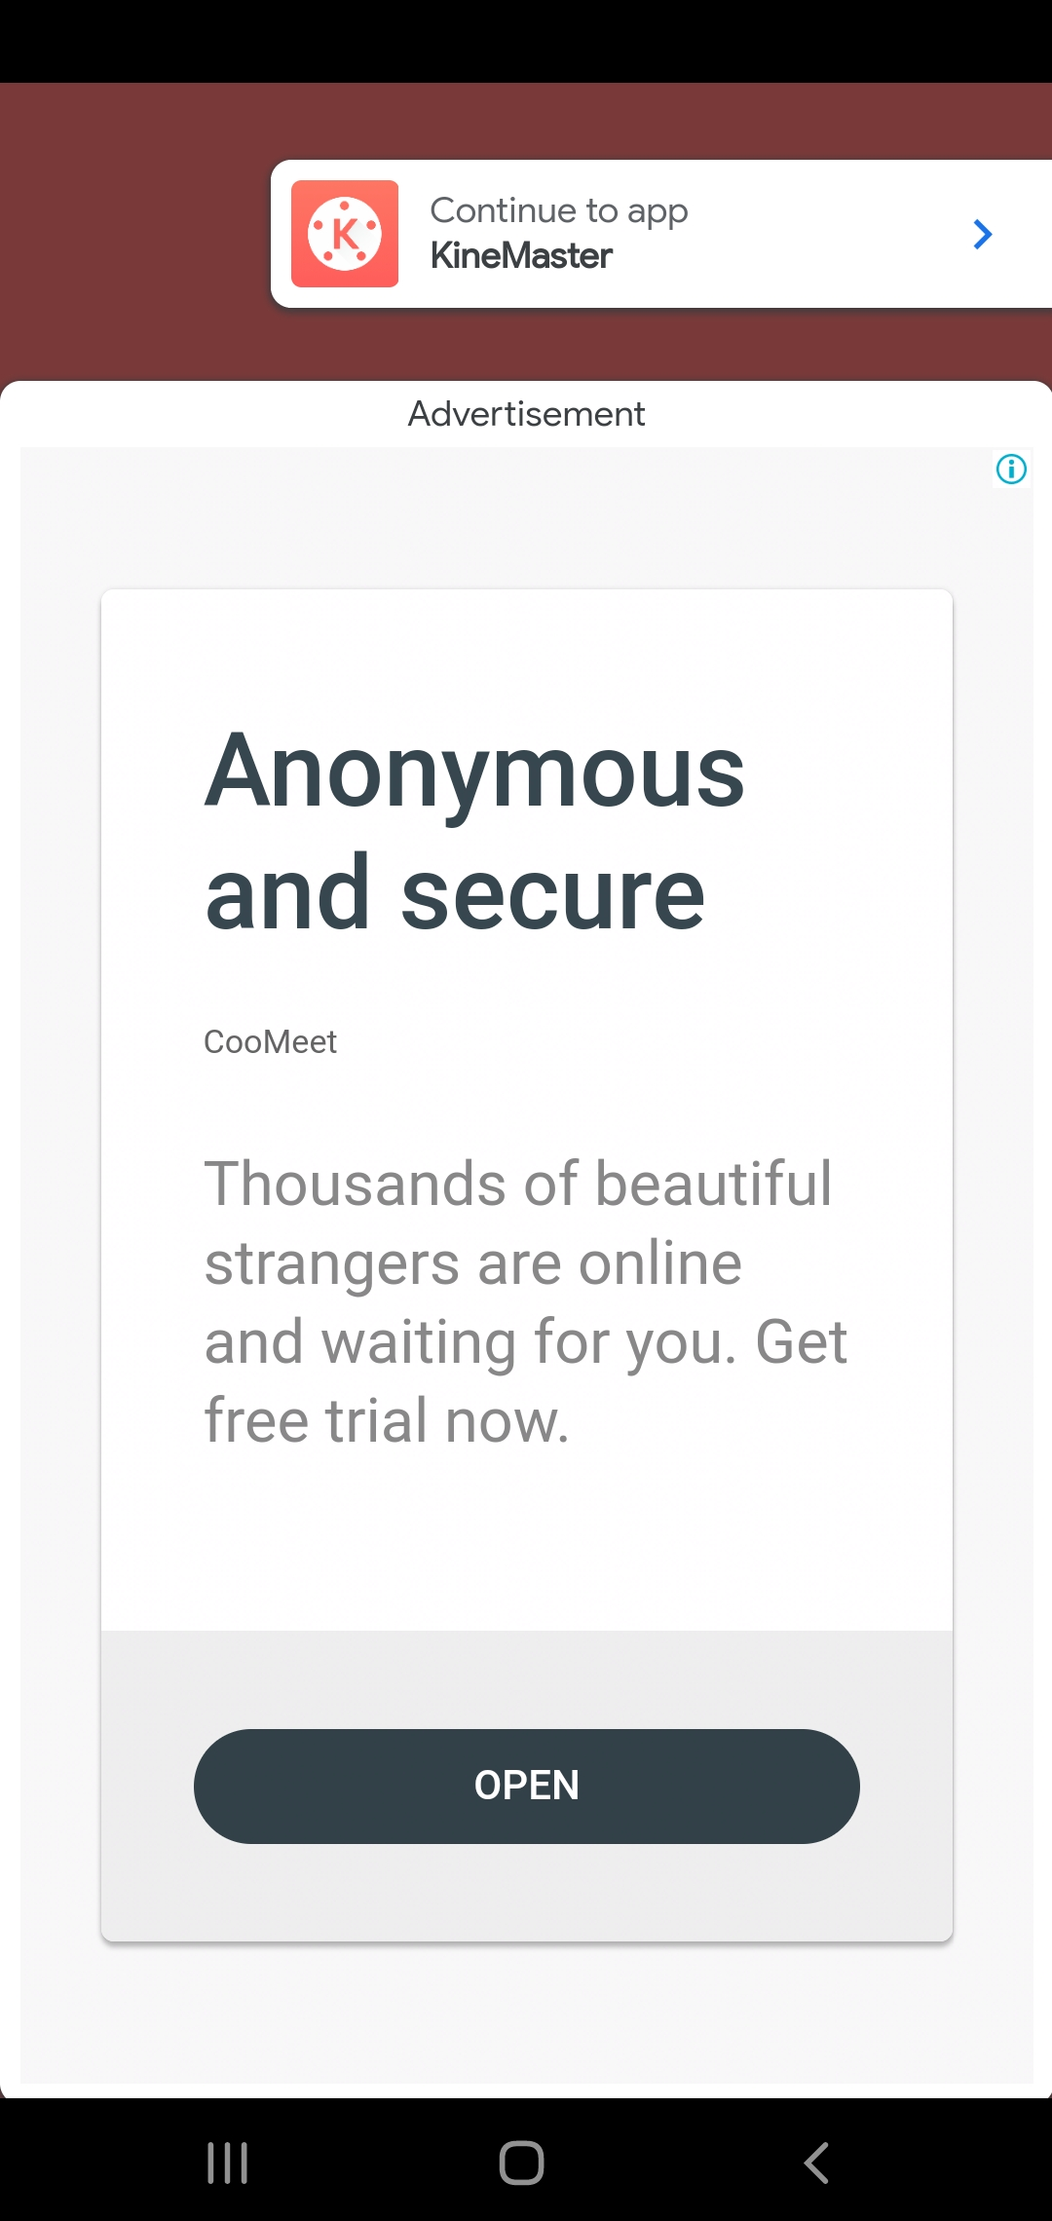

Slide 13
End

Slide 14
Problems
When does the ad show?
Before/After SplashScreen?
How to check the foreground status?
Implement LifecycleObserver? Or Add AdmobAdSplashActivity?
Do we need to set the timeout to close Ad automatically?
Do we show splash ad in the first time launching?
Notes:
KineMasterApplication Line:276

